Slide 1
Overrides
What do you do when you cannot register for a course?
Request an Override
You must meet the course requirements to request prerequisite requirements
Transfer student may have articulation issues.
Overrides can be processed for the following main reasons:
Class Capacity
Prerequisite
Repeat
How to request an override:
Contact the department that owns the course (see chart on next slide)
Include the following information
Net ID/ MSU ID: Jd123, 900111222
Course Information: EM 2413 01 Engineering Mechanics I (please include the section number)
Type of Override: Prerequisite override
Term: Winter or Spring
(please remember that you are asking for overrides for both winter and spring. It is important that you indicate the term)

Slide 2
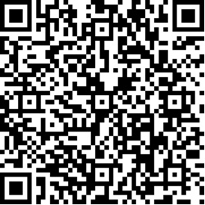
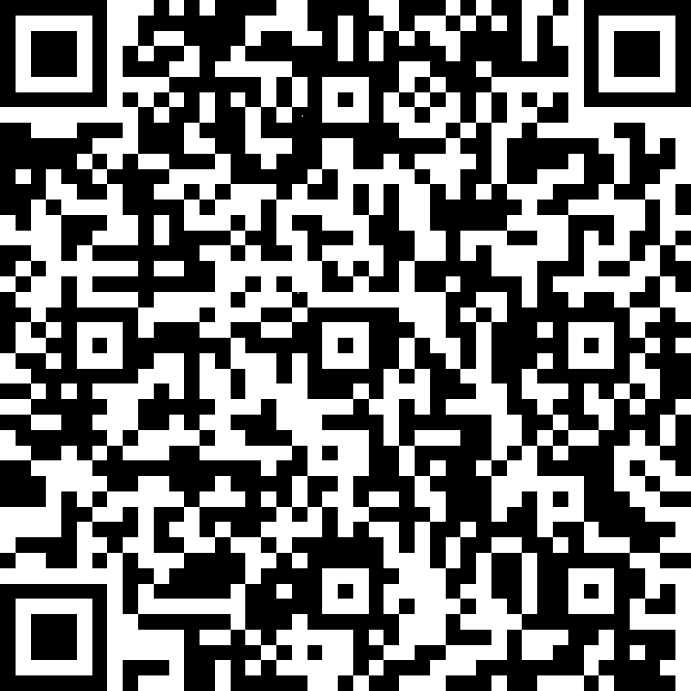
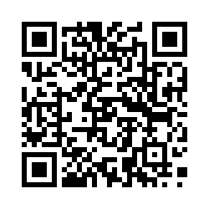
Override chart
Department | Override information | QR Code
Aerospace Engineering | Override@ae.msstate.edu
Computer Science | https://www.cse.msstate.edu/capacity-override-request-form/ or wdandass@cse.msstate.edu
Electrical & Computer Engineering | https://forms.office.com/Pages/ResponsePage.aspx?id=sNtR7YavokWcl3P7OTXfF5VWjuF4EqRFmv8Z3TVWNZxUME9INUs5S1ZJR1hGT1RGMVJNMTBKMlo3RS4u Or use the QR code
Mechanical Engineering | https://forms.office.com/Pages/ResponsePage.aspx?id=sNtR7YavokWcl3P7OTXfF1ITcLsT-ilMuRcPX9XYdDZUOVczNzUxOVpQWDAyTkRNWERQRkM3RzQ1US4u Or use the QR code:
Technical Writing (GE 3513) | https://forms.gle/7shQmYkU6hsK6j7q8.
Industrial Engineering | https://msstateengineering.qualtrics.com/jfe/form/SV_ePUI07ouzVAQR3D B
Math | Override@math.msstate.edu
Physics | srg133@msstate.edu
Civil Engineer | kwilliams@cee.msstate.edu and copy email to Truax@cee.msstate.edu

